Slide 1

Lab 4

Slide 2
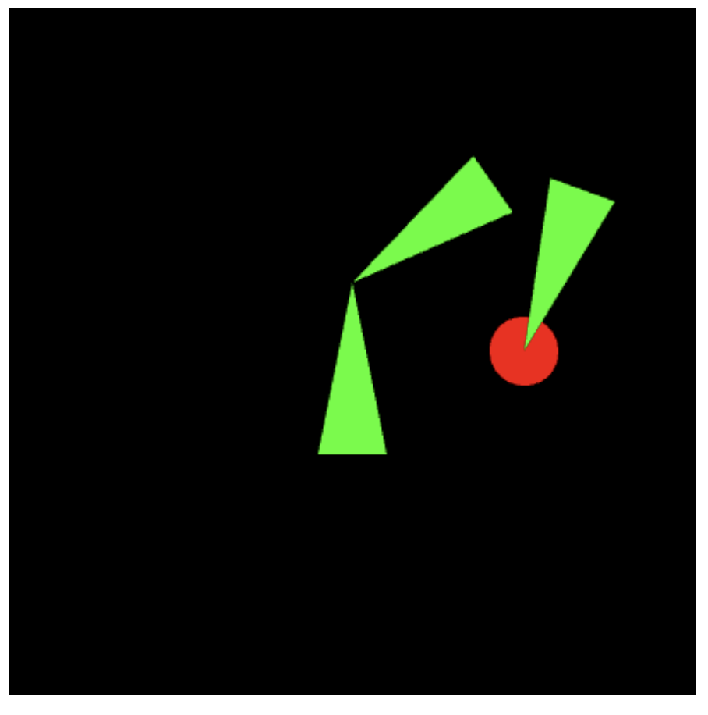
Check the video in the folder
This is an extension of Lab3
The template already gives you 2 triangles (same as Lab3). When you press ‘a’, ‘s’, ‘d’, ‘w’, you can move the 2 triangle to left, down, right, up. When you press ‘r’, one triangle can rotate
There are a circle and a rotating triangle (they are an object set)
Requirements of this practice
When the left corner of the triangle 2 touches the circle, the color of the circle change to ‘light green’
When any part of the circle touches the left corner and the user press ‘g’ , the color of the circle change to ‘dark green’ and the center of the circle attaches on the left corner. Now, the circle is in the ‘grabbed mode’.
In the grabbed mode, when users move the triangle1 or rotate triangle2, the circle and the rotating triangle should move along with them.
In the grabbed mode, when users press ‘g’ again, it leaves ‘grabbed mode’. The circle stays at its current location
Left corner
triangle2
triangle1

Slide 3
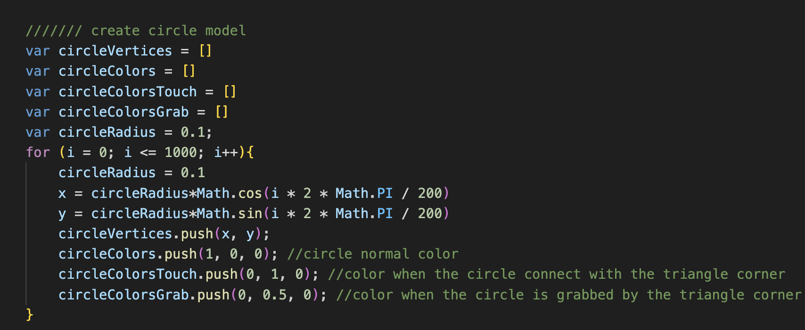
This create a circle model
The circle consists of many small triangles
I also create three different color arrays for the normal mode, touch mode and grabbed mode
The circle radius is 0.1 in the world space

Slide 4
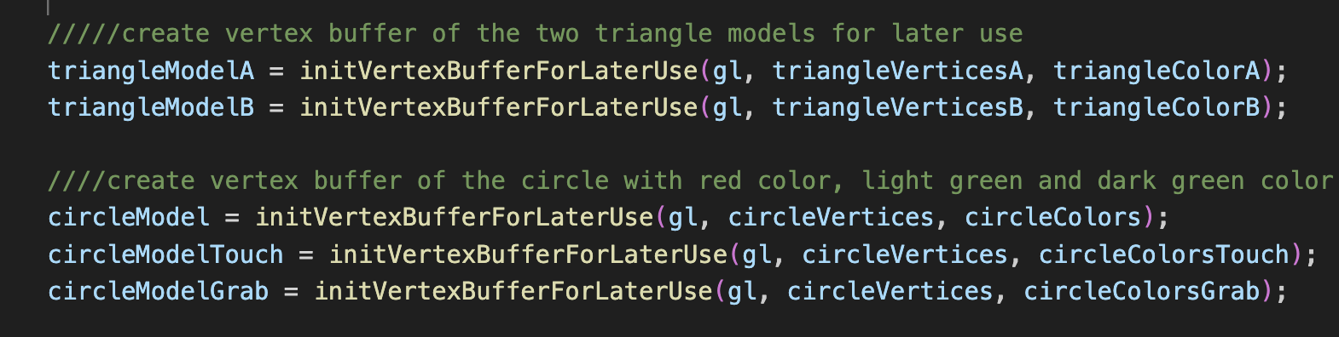
Setup the VBOs of triangles and circles with different colors

Slide 5
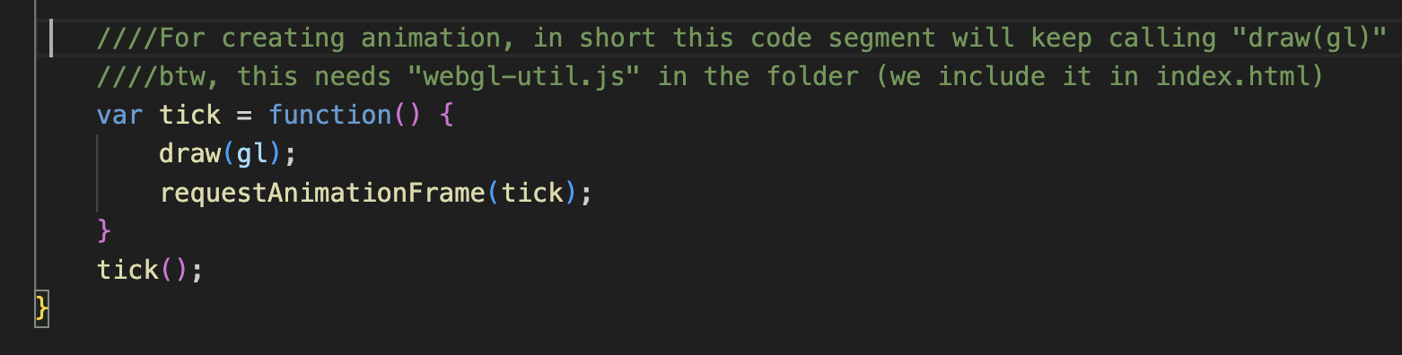
This is how we make the animation. In short, the function, draw(), is called repeatedly.
We require a file, webgl-util.js in the working folder

Slide 6
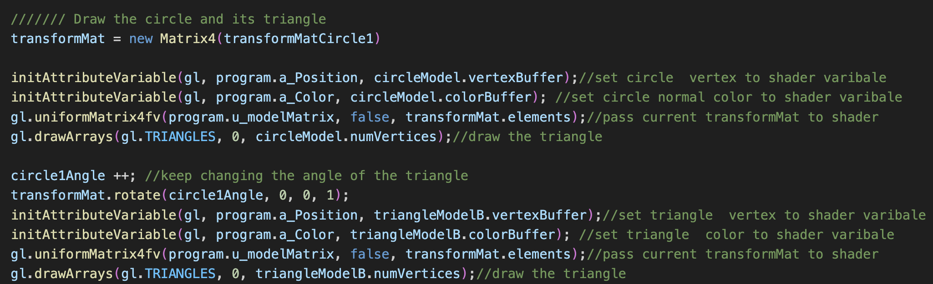
Draw the circle and the rotating triangle

Slide 7
Check triangle2 left corner touches the circle?
Get the corner’s coordinate and circle’s coordinate in the “world space” to compare
worldSpaceCoordinate = transformationMatrix * objectSpaceCoordinate

Slide 8
Hierarchical structure of this practice (non-grabbed mode)
Transformation that locates triangle1
in the world space
Transformation that locates the circle in the world space
Draw triangle1
Draw circle
Transformation information that includes attaching two tips of triangles and rotation angles of the triangle2
Transformation information that includes attaching the tip of the triangle at the circle center and rotation angles of the triangle
Draw triangle2
Draw rotating triangle

Slide 9
Hierarchical structure of this practice (non-grabbed mode)
Transformation that locates triangle1
in the world space
Transformation information that can attach the circle center at the triangle2’s left corner
Draw triangle1
Draw circle
Transformation information that includes attaching two tips of triangles and rotation angles of the triangle2
Transformation information that includes attaching the tip of the triangle at the circle center and rotation angles of the triangle
Draw triangle2
Draw rotating triangle

Slide 10
What You Should Do for “Submission”

Slide 11
Submission Instruction
Create a folder
Put the html and js files in the folder
Zip the folder
Rename the zip file to your student ID
For example, if your student ID is “40312345s”, rename the zip file to “40312345s.zip”
Submit the renamed zip file to Moodle
Make sure
you put all files in the folder to zip
You submit the zip file with correct name
You won’t get any point if
the submitted file does not follow the naming rule,
TA cannot run your code,
or cannot unzip your zip file.

